Slide 1

Deep Fake Detection using Deep Neural Architectures
Team 2
Pruthivi Raj Behera (MT20037)
Prabal Jain (MT20115)
T G Narayanan (MT20027)

Slide 2
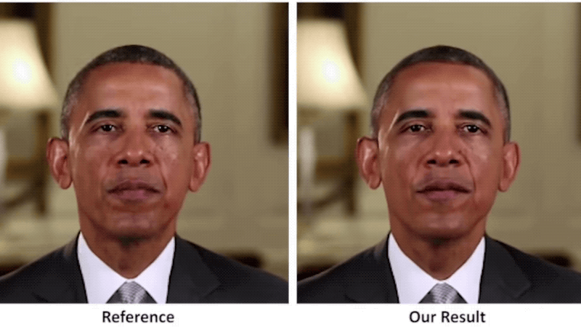
Problem Statement
Revenge Porn : Deepfakes were used to swap faces of celebrities or politicians to bodies in porn images and videos. The first deepfake video emerged in 2017 where face of a celebrity was swapped to face of a porn actor.
Falsification : Videos of world leaders with fake speeches for falsification purposes
Threat to violation of privacy and identity
Fake News
Financial Fraud
Source : https://www.theverge.com/tldr/2018/4/17/17247334/ai-fake-news-video-barack-obama-jordan-peele-buzzfeed

Slide 3
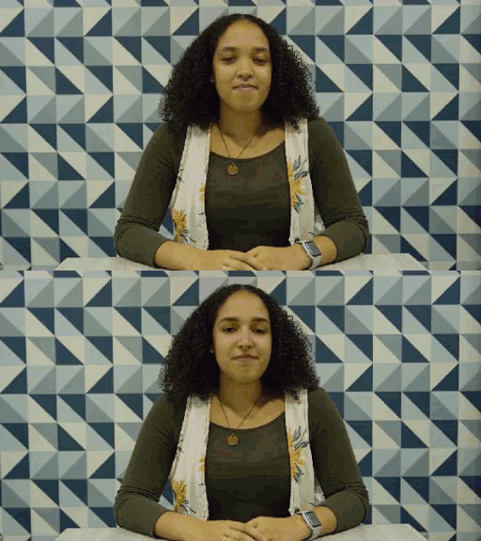
Motivation
Can you Distinguish Between Real and Deep Fake Video?

Slide 4
Motivation
To Design and Develop a Deep Learning algorithm to classify the video as deepfake or Real

Slide 5
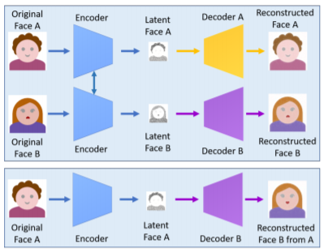
Deep Fake : CREATION
Encoder-Decoder : Two Encoder Decoder is needed For Face - Swapping where each Pair is used to train on Image Set and Encoder Parameters are shared Between Two Networks.
Source Image : https://arxiv.org/pdf/1909.11573.pdf
Notes:
In other words, two pairs have the same encoder network. This strategy enables the common encoder to find and learn the similarity between two sets of face images, which are relatively unchallenging because faces normally have similar features such as eyes, nose, mouth positions

Slide 6
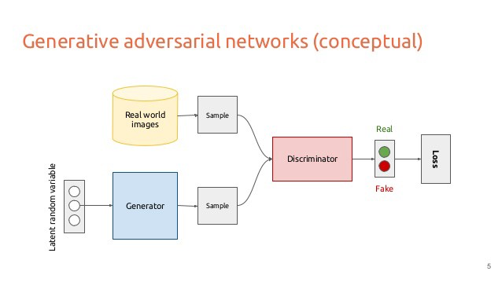
Deep Fake : CREATION
2. GAN’s : By adding adversarial loss and perceptual loss (implemented in VGGFace) to the encoder-decoder architecture, an improved version of deepfakes based on the generative adversarial network (GAN)
Source Image : https://towardsdatascience.com/deepfakes-the-ugly-and-the-good-49115643d8dd
Notes:
In other words, two pairs have the same encoder network. This strategy enables the common encoder to find and learn the similarity between two sets of face images, which are relatively unchallenging because faces normally have similar features such as eyes, nose, mouth positions

Slide 7
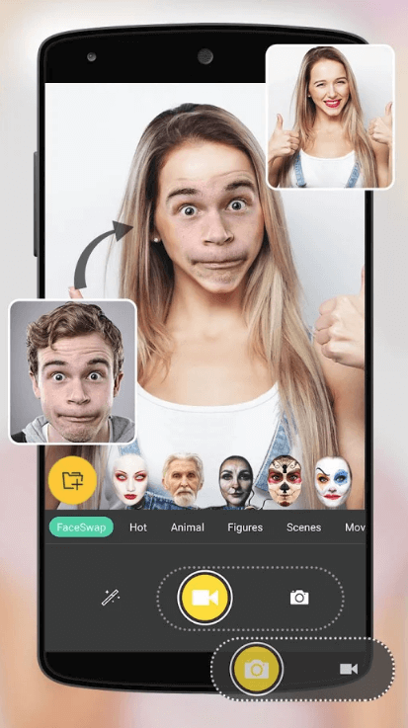
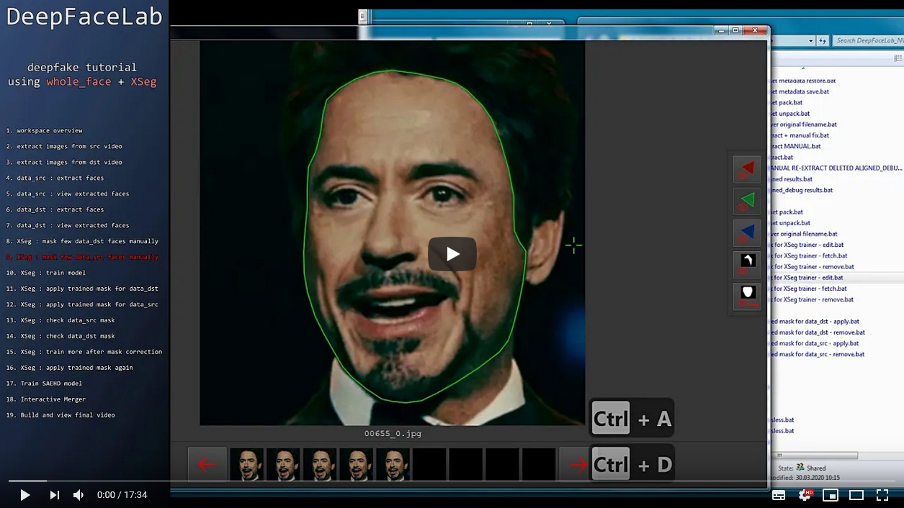
DeepFake Creation :Examples
FaceSwap, DeepFace Lab, Faceit, FaceMask, DFaker
DeepFake tf, FaceSwap-GAN etc.

Slide 8
Deep Fake : Detection (Literature Survey)
Analysing Convolution Traces.
(Source : https://arxiv.org/abs/2004.10448)
Using Ensembling : Deep Pre Trained Convolutional Neural Networks
(Source : https://arxiv.org/pdf/2003.08645.pdf)
Mesonet
(Source : https://arxiv.org/pdf/1809.00888.pdf)
Notes:
Most recent work done is done by [5] in this field with convolutional traces. In this paper, a novel deepfake detection method focused on images representing human faces (convolutional traces) was introduced. FACEFORENSICS++, etc. were used to generate deepfake and classification tests were carried out on the obtained feature vectors with highest accuracies in range of 92-97%.
To Extract the Convolutional Traces Expectation-Maximization Algorithm was used which captured the correlation among the pixels to discriminate between the real ones and Fake ones. Different GAN’s like STYLEGAN2.
Hence Different State of art Methods for Detecting Deep Fake required Pretrained Models like XceptionNet, MobileNet, SqueezeNet, Inception Net, etc. performs well on FaceForensics++ Dataset, Celeb-DF Dataset.

Slide 9
Dataset Exploration :
Dataset Used : DFDC Kaggle Dataset
More than 100,000 Videos.
Featuring eight facial modification algorithms
Actors were Paid to create Deep Fake Videos.
Dataset was Divided into 50 Batches.

Slide 10

Baselines :
For Baseline we Created
Two Baseline Models each With Two Variants
Deep Convolutional Neural Network (CNN-SGD, CNN-ADAM)
MesoNet (Meso-1 and Meso-4)

Slide 11
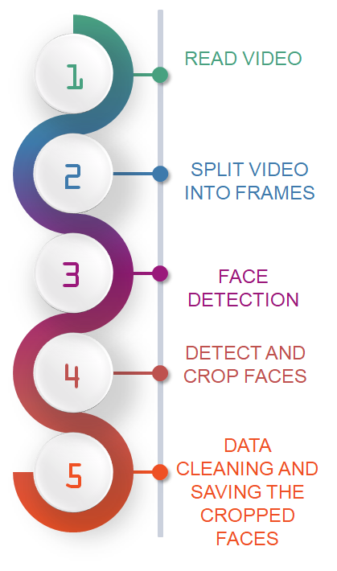
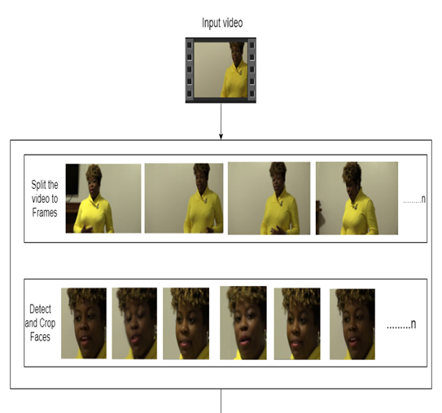
Dataset Preprocessing :

Slide 12
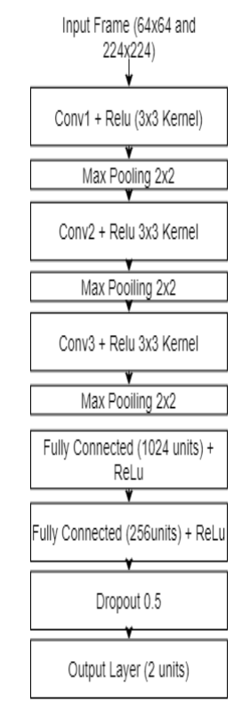
Baseline : CNN
Variant : CNN-SGD
Architecture

Slide 13
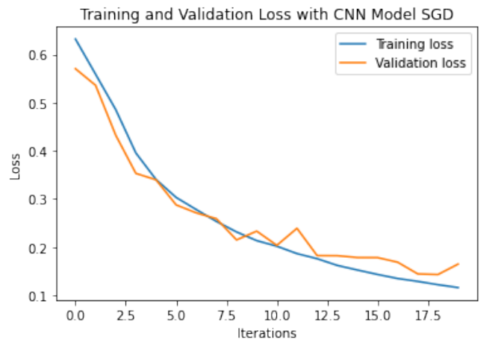
Baseline :CNN
Variant : CNN-SGD
Loss Plot

Slide 14
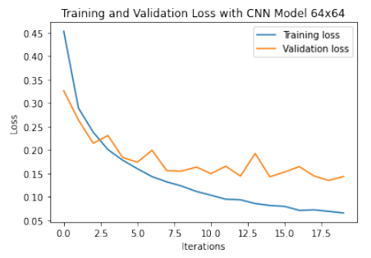
Baseline :CNN
Variant : CNN-ADAM
Loss Plot

Slide 15
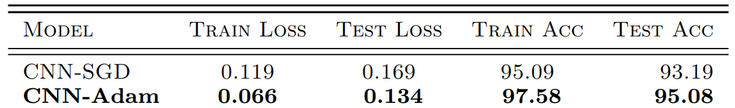
Baseline :CNN
Final Result :

Slide 16
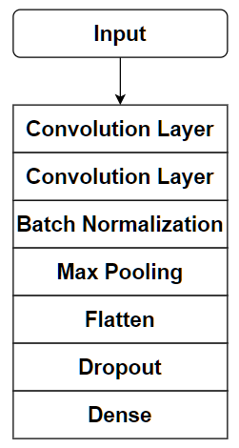
Baseline :Mesonet
Variant : Meso1
Architecture

Slide 17
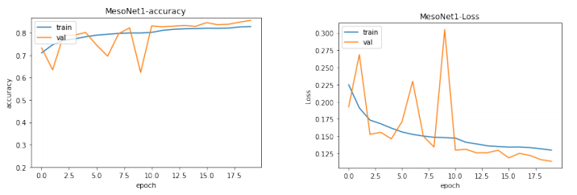
Baseline :Mesonet
Variant : Meso1
Accuracy and Loss Plots

Slide 18
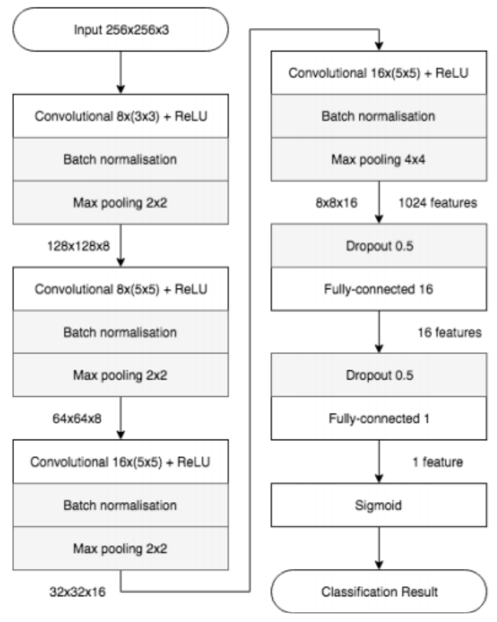
Baseline :MesoNet 4
Variant : Meso4
Architecture

Slide 19
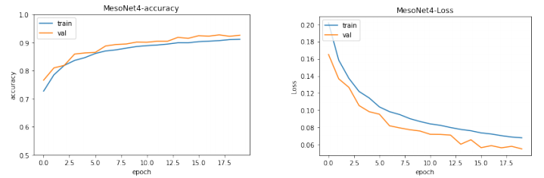
Baseline :MesoNet
Variant : Meso4
Accuracy and Loss PLot

Slide 20
Baseline :MesoNet
Variant : Meso4
Results

Slide 21
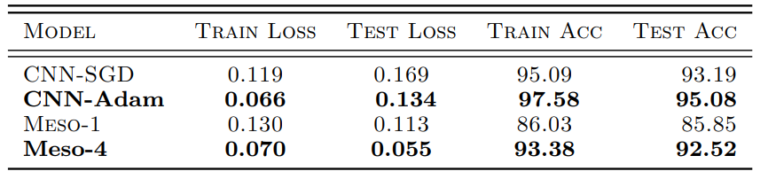
Baseline :Results

Slide 22
Baseline :LimiTATIONS/ASSUMPTIONS
Due to computational bottleneck, baseline was performed on a single batch ‘’dfdc_train-part_13.zip’’
Furthermore 3 Parts were taken from Batch ‘’dfdc_train-part_13.zip’’.
Key Observations : High Correlation among data as it was created by few actors.
Biased Model : Model was Biased towards the Data
Class Imbalance : More number of Fake Videos as compared to real Videos.

Slide 23
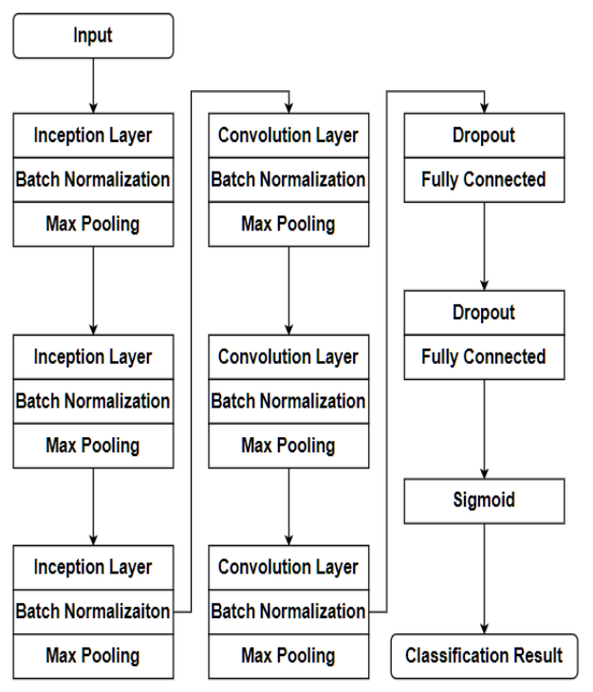
Our Pipeline :

Slide 24
Why Inception Module Works?

Slide 25
Why Inception Module Works?
Advantages :
Inception Modules are used in Convolutional Neural Networks to allow for more efficient computation and deeper Networks through a dimensionality reduction with stacked 1×1 convolutions
The modules were designed to solve the problem of computational expense, as well as overfitting

Slide 26
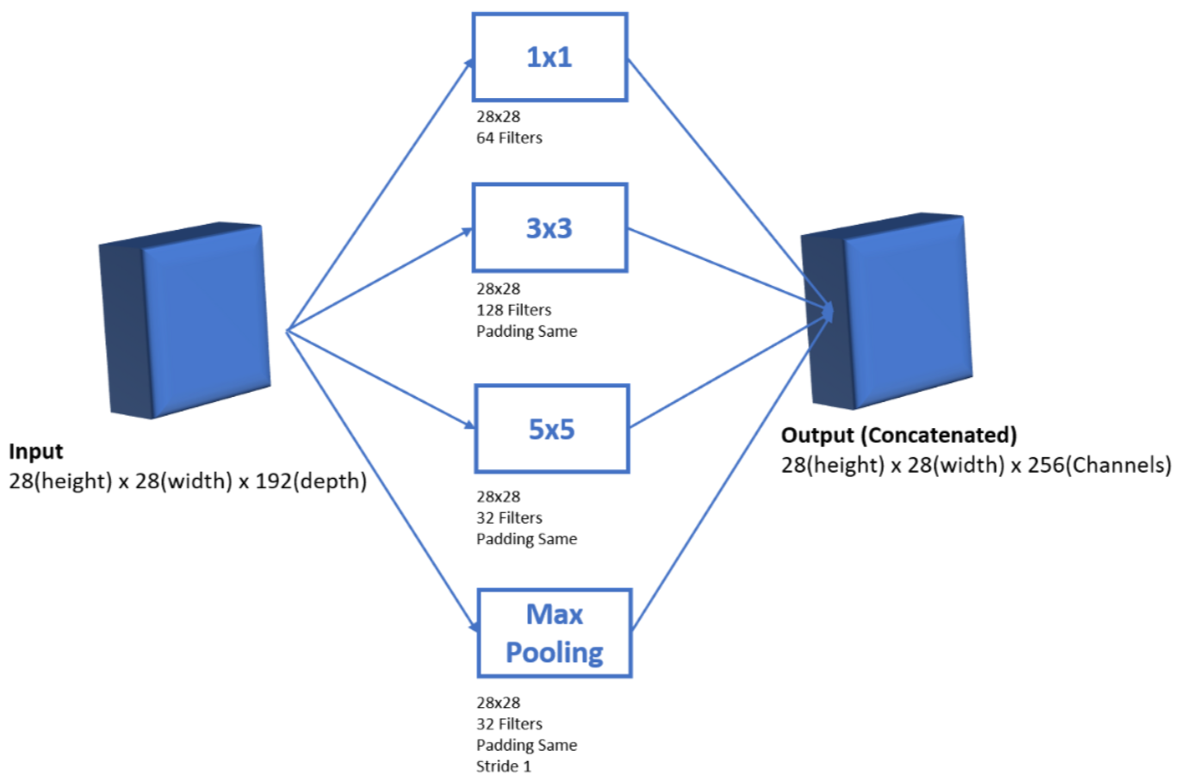
Inception Model

Slide 27
Proposed Model : Methodology
Frame by Frame classification approach i.e., for each of the frames extracted from the video, our model will classify it as real or fake based on the model and a majority vote.
We came across a huge data which contains 124k videos with eight facial modification algorithm. Data was further divided into 50 batches. As per our Computational Threshold, we decided to extract 100 videos from each batch to make our data normalized and not biased towards the count of fake and real video. We decided to use 100 videos from each batch in which 50 were fake, and the remaining 50 were real.

Slide 28
Proposed Model : Methodology
We used fake videos corresponding to the real video for efficient learning, so our final data contains 5000 videos in which 2500 videos were fake, and 2500 videos were real corresponding to the fake videos.
During the Literature Survey of various frame-by-frame approaches, we found that 32 frames per video perform well on Deep Convolutional Neural Network models.
The face is essential in detecting deepfakes, so we used a simple MTCNN detector to extract faces from the images.
During face extraction, we found out that some images extracted from the videos by MTCNN were not required faces here we performed Data Cleaning.

Slide 29
Proposed Model : Methodology
Our data contains 159116 frames with the corresponding label.
We resized our images to 256x256.
To train our model on this data, we decided our train data to be 80 percent, out of which 20 percent is validation data and the remaining 20 percent for test data.
So we train our model on 101833 frames and perform predictions on 25459 frames we were able to achieve an accuracy of 80.4684%.
For our model, we tried with epochs [10,20,30], and we found out that after 30 epochs model starts to vary a lot in terms of loss and accuracy on validation data.

Slide 30
Hyperparameters : InceptionConv
Training on 10 Epochs
Batch Size : 256
Optimizer : Adam
Learning Rate : 0.001
Loss Function : Binary Cross Entropy Loss
Metric: Accuracy
Activation: Relu
Classification layer activation: Sigmoid
Dropout : 0.5
3 Inception modules followed by 3 Convolution layers.

Slide 31
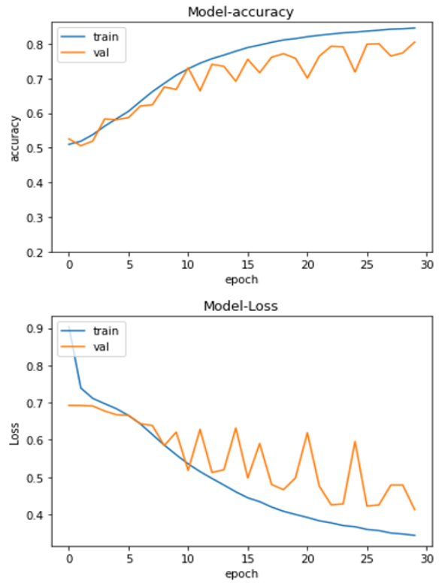
Proposed Model : Results
Accuracy and Loss Plots

Slide 32
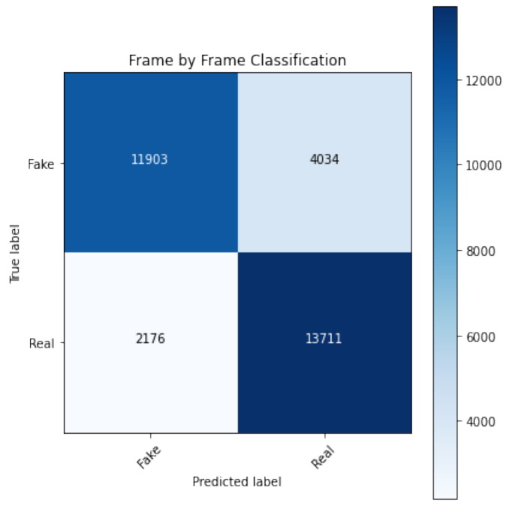
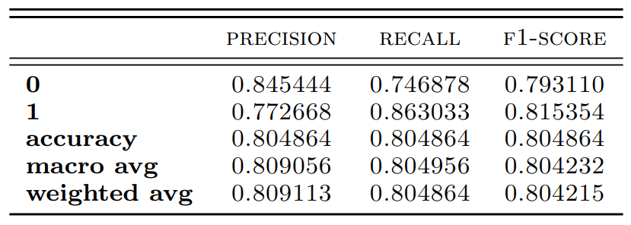
Proposed Model : Results
Results :Classification Report and Confusion Matrix
Classes -> [0 and 1]
1 -> [Real], 0-> [Fake]

Slide 33
Proposed Model : Errors
Insights :
MesoNet1 performs inefficiently as Convolutional Neural Network should be Sufficiently Wide and Sufficiently Deep.
Limitation of MesoNet4 : As model was biased towards the data and hence it performs inefficiently on the whole dataset.
InceptionConv Model Fails when there are multiple faces in a video.
Sometime MTCNN gives Inaccurate Face Extraction.

Slide 34

Proposed Model : Errors
Multiple Face Extraction Leads to False Classification
(32 frames per image)

Slide 35
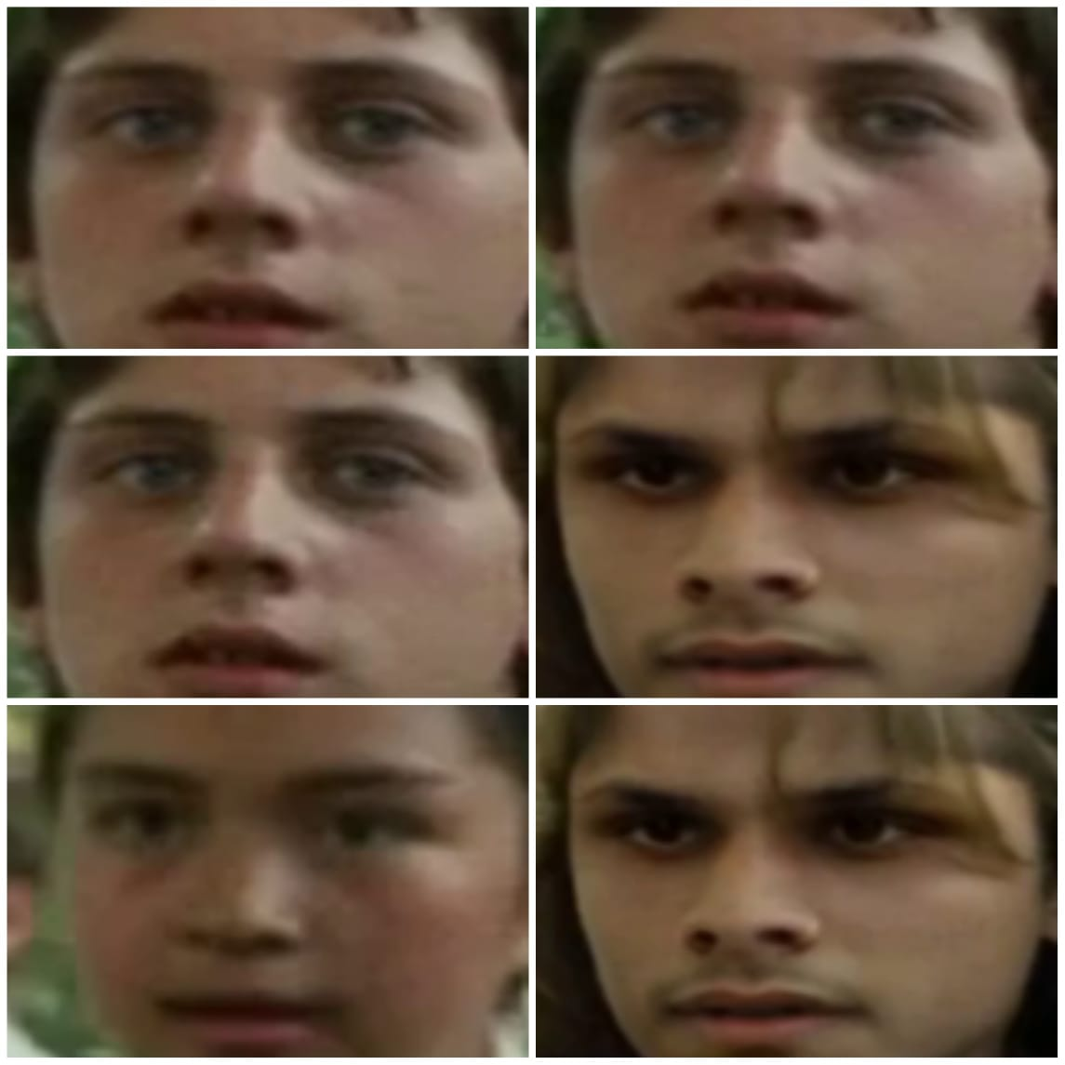
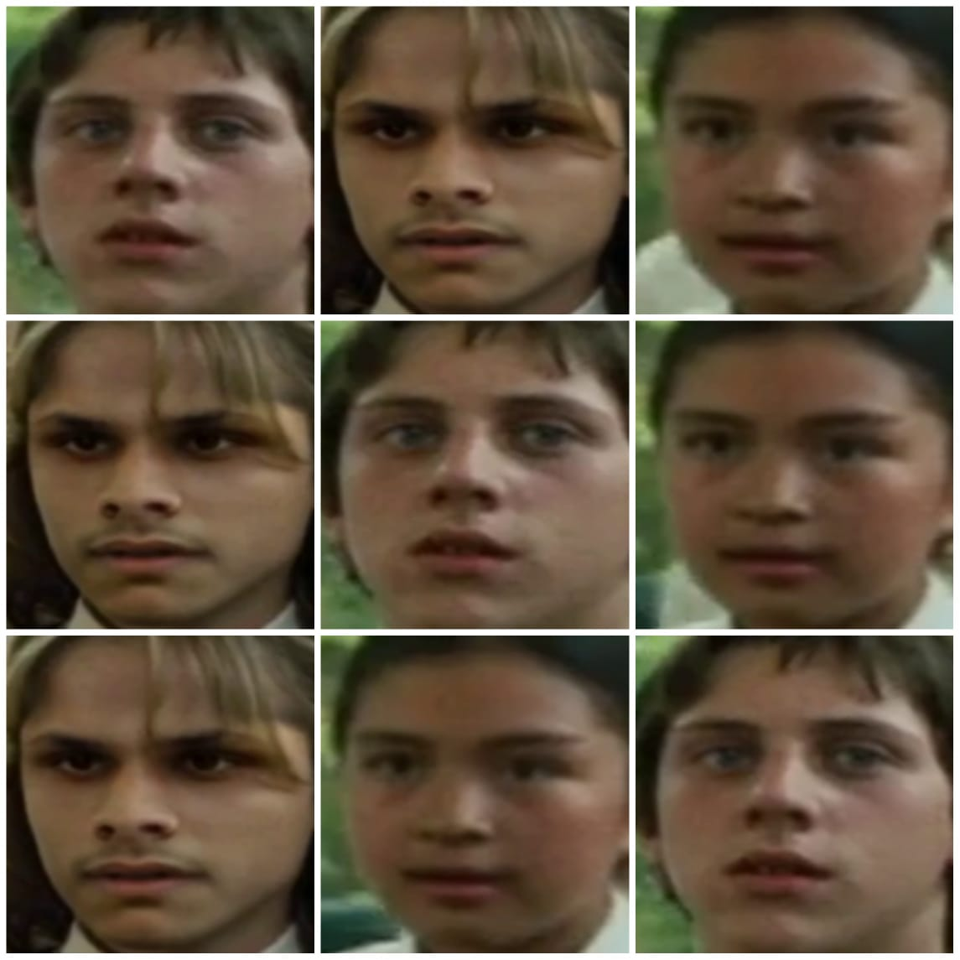
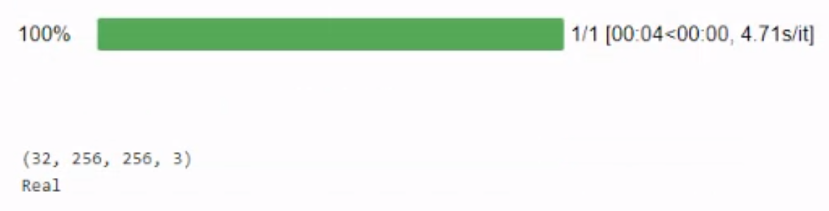

Slide 36
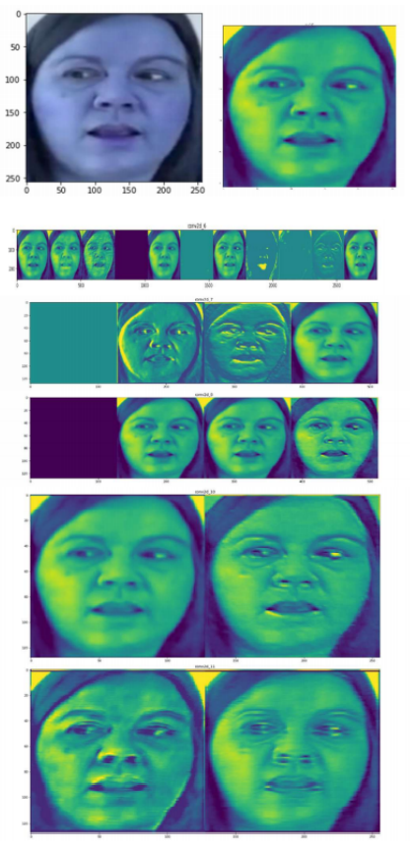
Proposed Model : Visualization
Feature Map Visualization
Visualising Filters and Feature Maps for Deep Learning are easier to tune, since we can see an error made by the network and can point out the cause directly.

Slide 37
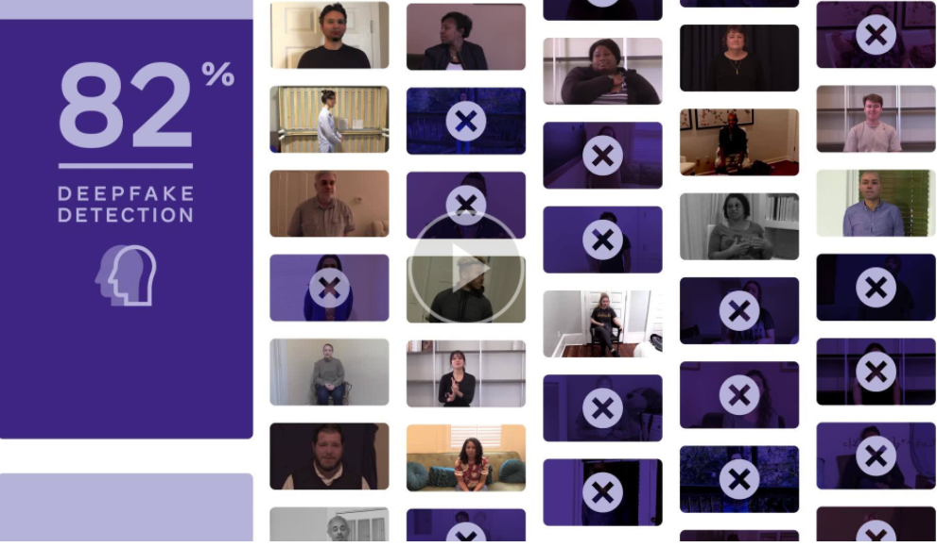
Conclusion :
Facebook reported Highest Accuracy on whole Dataset : 82%
Kaggle Winner Profile : https://www.kaggle.com/selimsef
(Pretrained Encoder Models were used like EfficientNet b7, trained on 4 GPU’s, 2500 iteration per epoch )
We were able to achieve 80% Accuracy on DFDC Dataset
(5000 Videos with equal distribution of Fake and Real Videos)
We might Achieve more accuracy if Provided GPU Processing
On whole Dataset of 124k videos.
Note : No Pretrained Model is used in this Project

Slide 38
Contribution by team members
Pruthivi Raj Behera: Preprocessing of Video Batch [0- 17], Baseline Meso1, Proposed Architecture, Implementation of InceptionModule, Training Model.
Prabal Jain : Preprocessing of Video Batch [18-35], Baseline Meso4, Analysis, Hyperparameter Tuning on InceptionConv, Training Model.
T G Narayanan : Preprocessing of Video Batch [36-49], Data Cleaning, CNN-Adam, CNN-SGD Implementation, Hyperparameter Tuning InceptionConv, Training Model Report.

Slide 39


Slide 40
Thank You !

